Slide 1
Nyan Gab
Analysis of hate speech on gab

Slide 2
Recap
Method – Linear classifier to classify Gabs as hate, offensive or neither
Data collected – 18,562 Gabs collected using snowball methodology, 10,000 users (with metadata such as username, gabs, followers, following, etc)
Network analysis
Since then
Analysis of trending topics and posts
Case study of Pittsburgh synagogue shooter
Draft of final poster

Slide 3
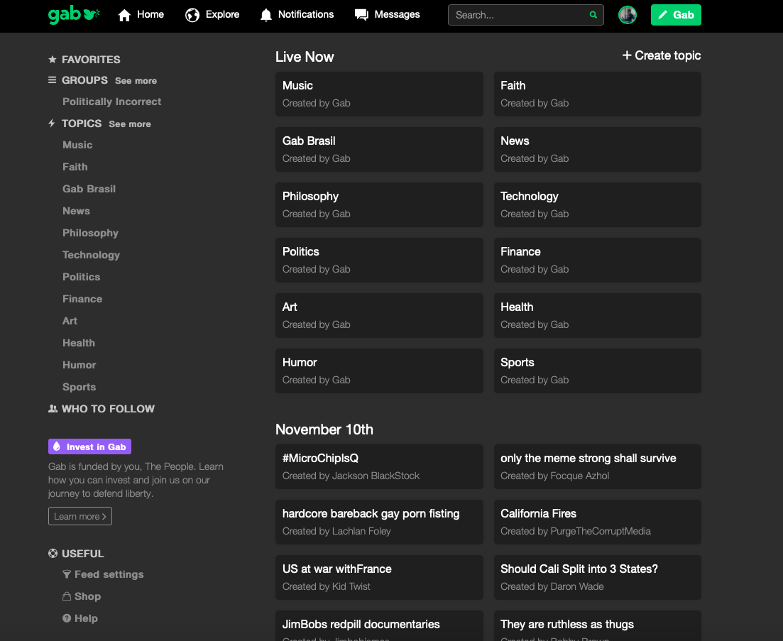
Trending topics

Slide 4
Trending topic titles

Slide 5
Trending gabs

Slide 6
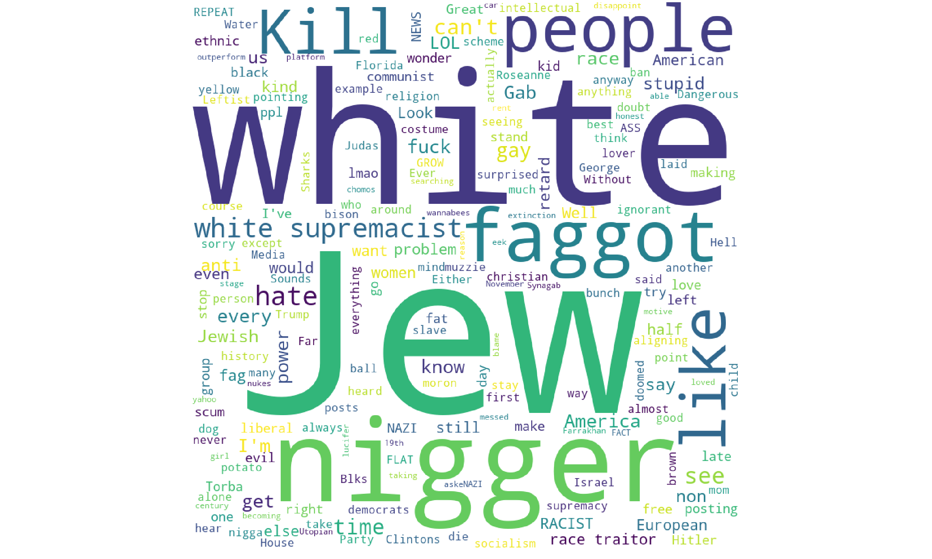
Trending hate gabs

Slide 7
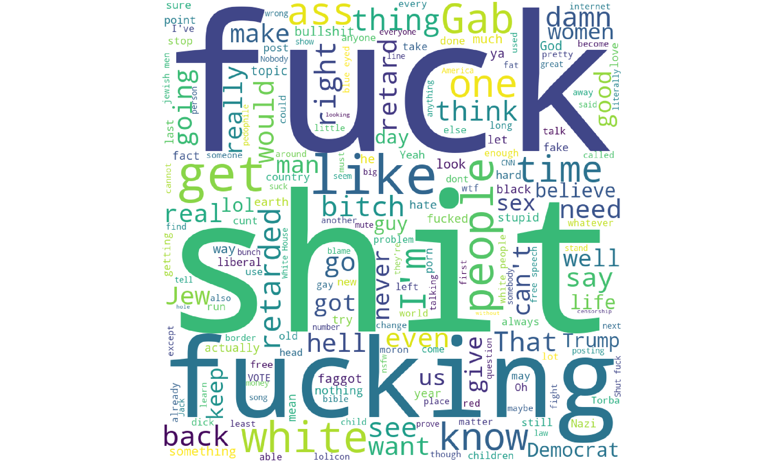
Trending offensive gabs

Slide 8
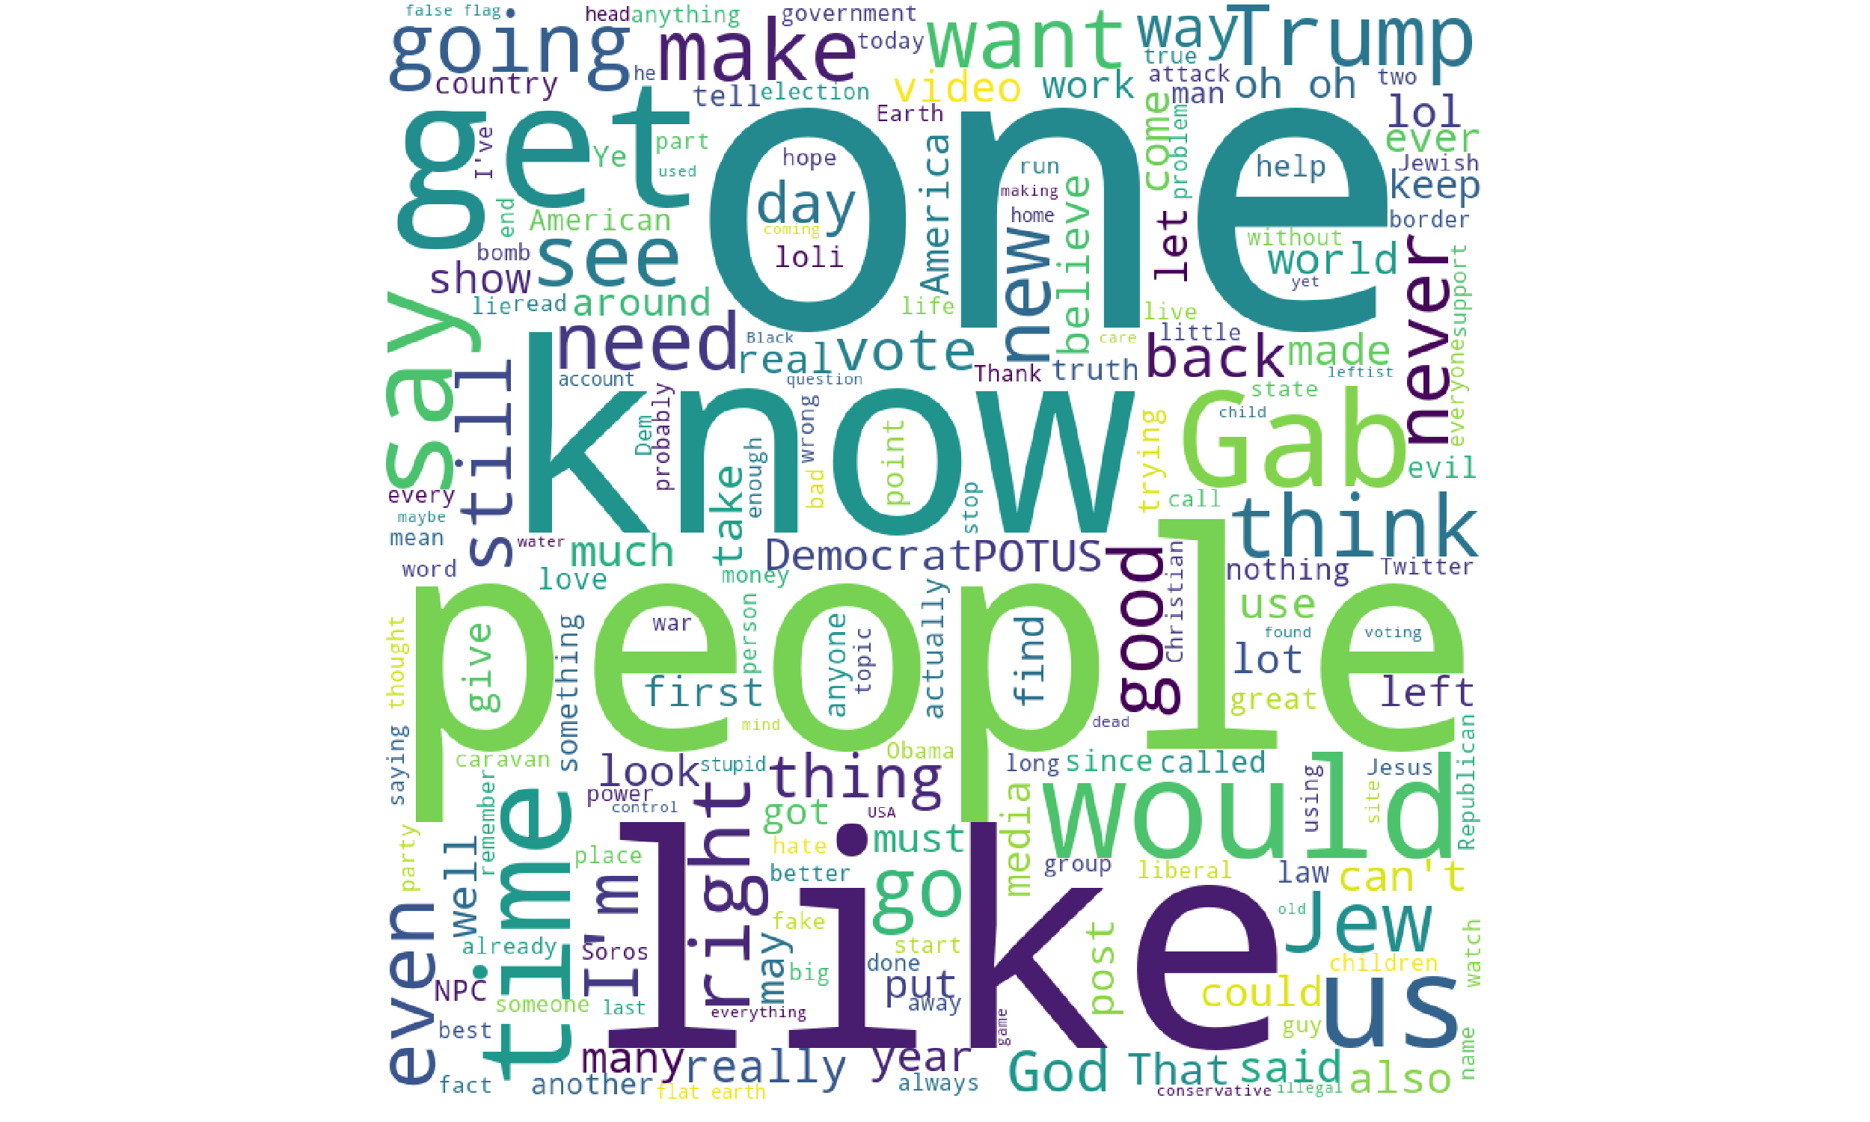
Trending neutral gabs

Slide 9
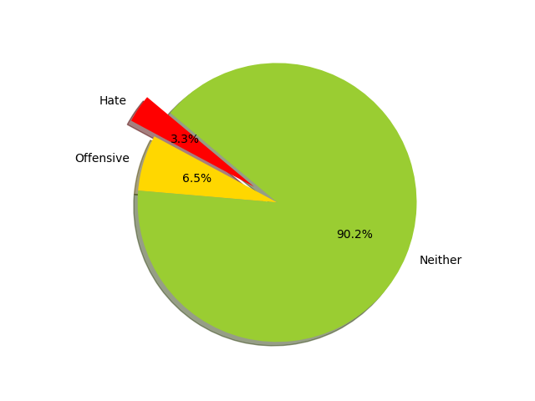
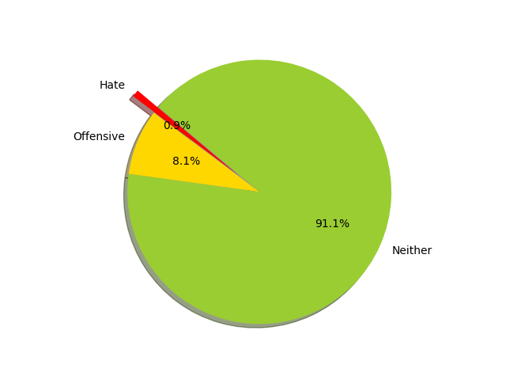
Case Study – Robert Bowers
Robert Bowers
All of Gab

Slide 10

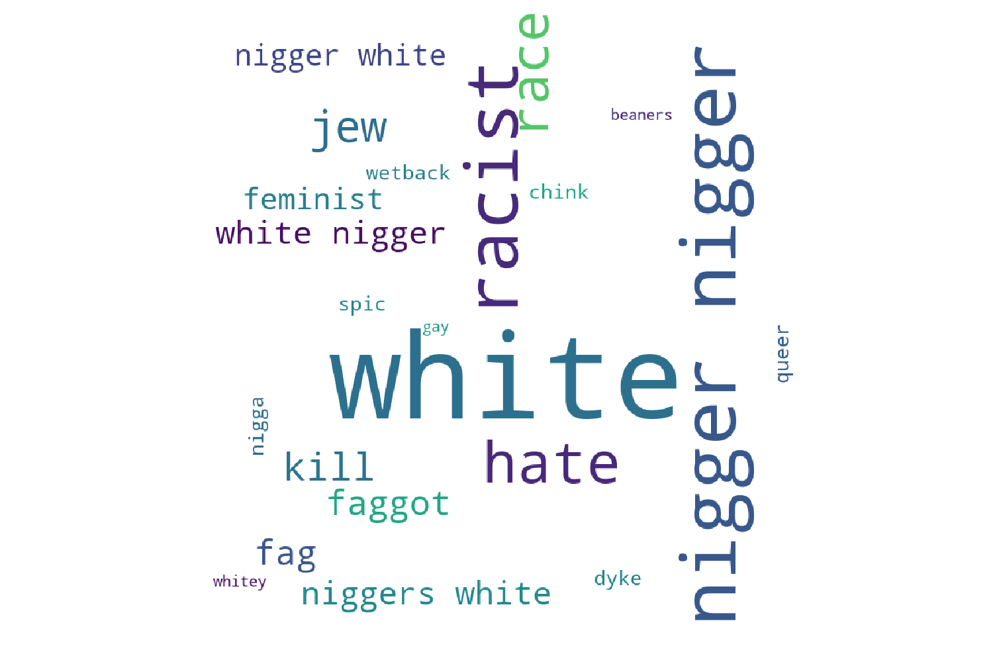
Hate words
Robert Bowers
All of Gab

Slide 11
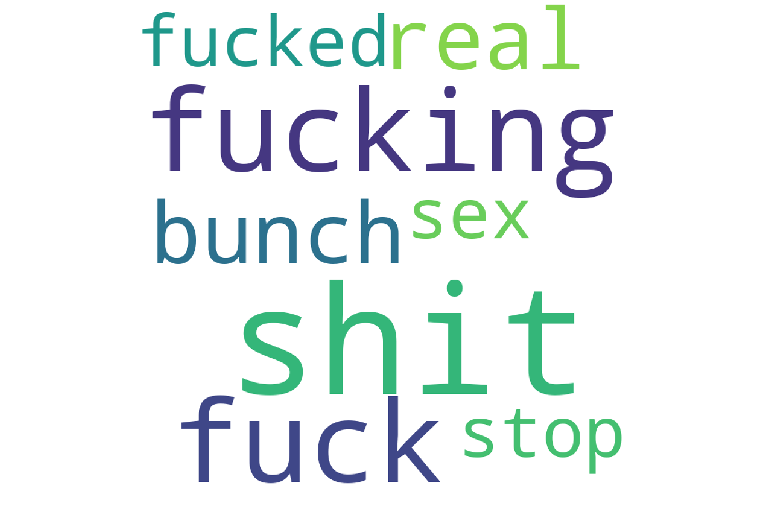
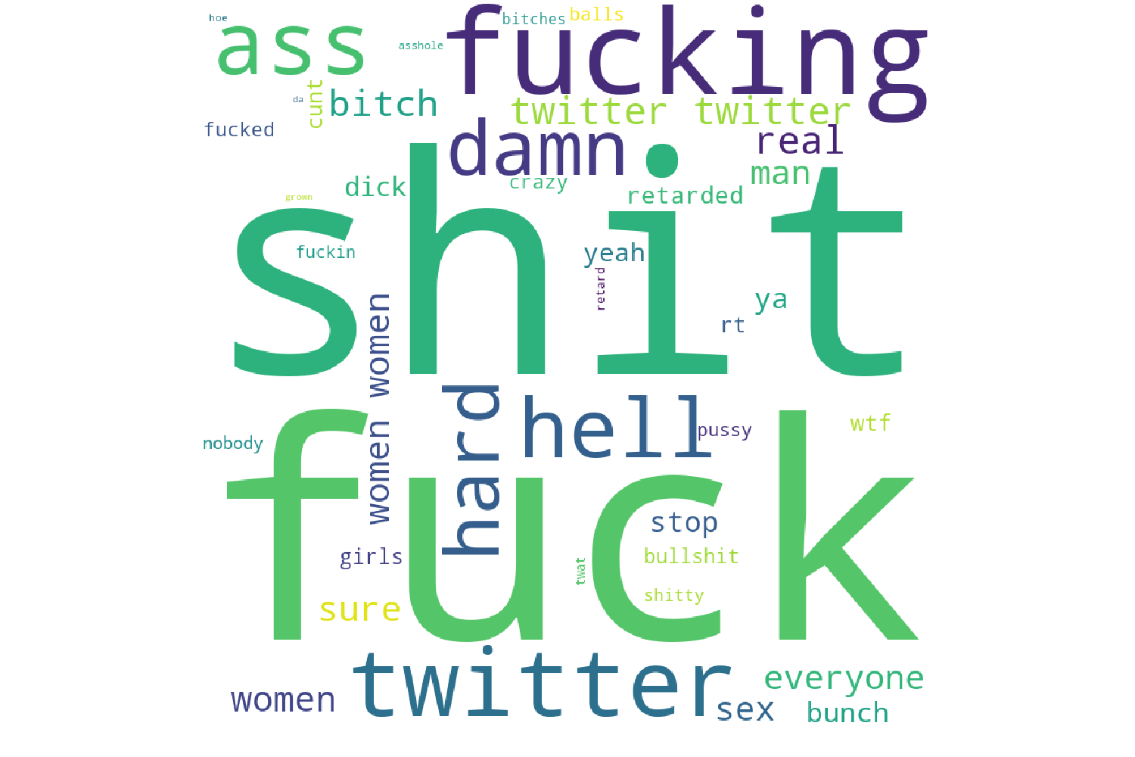
Offensive words
Robert Bowers
All of Gab

Slide 12
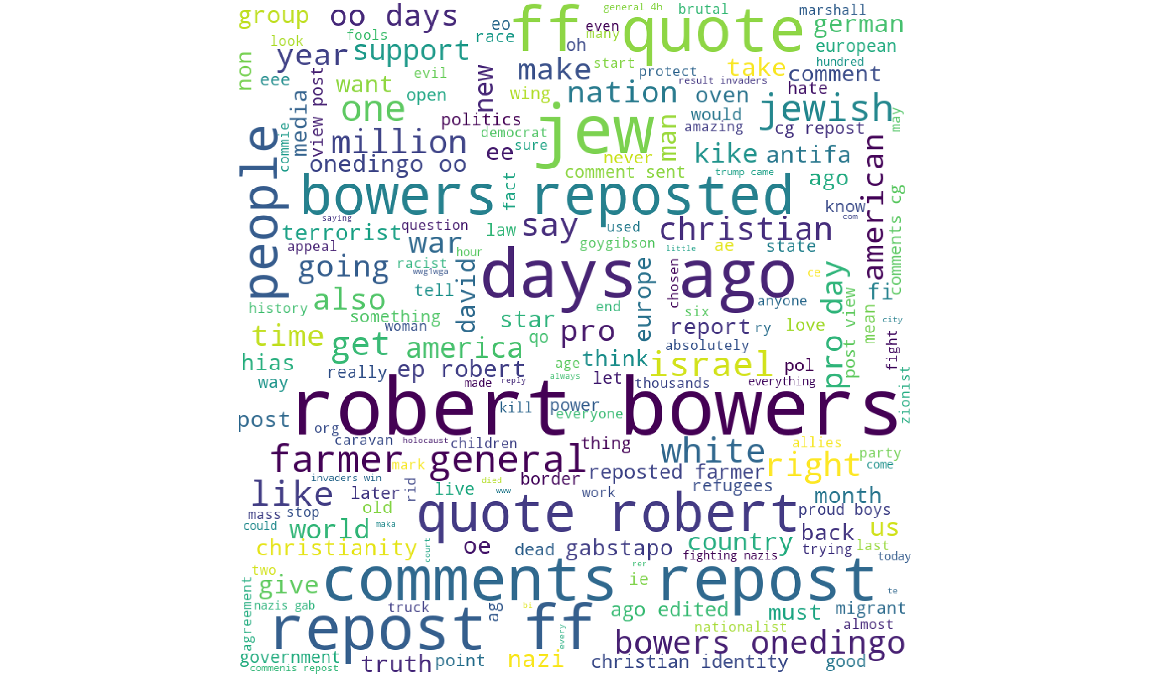
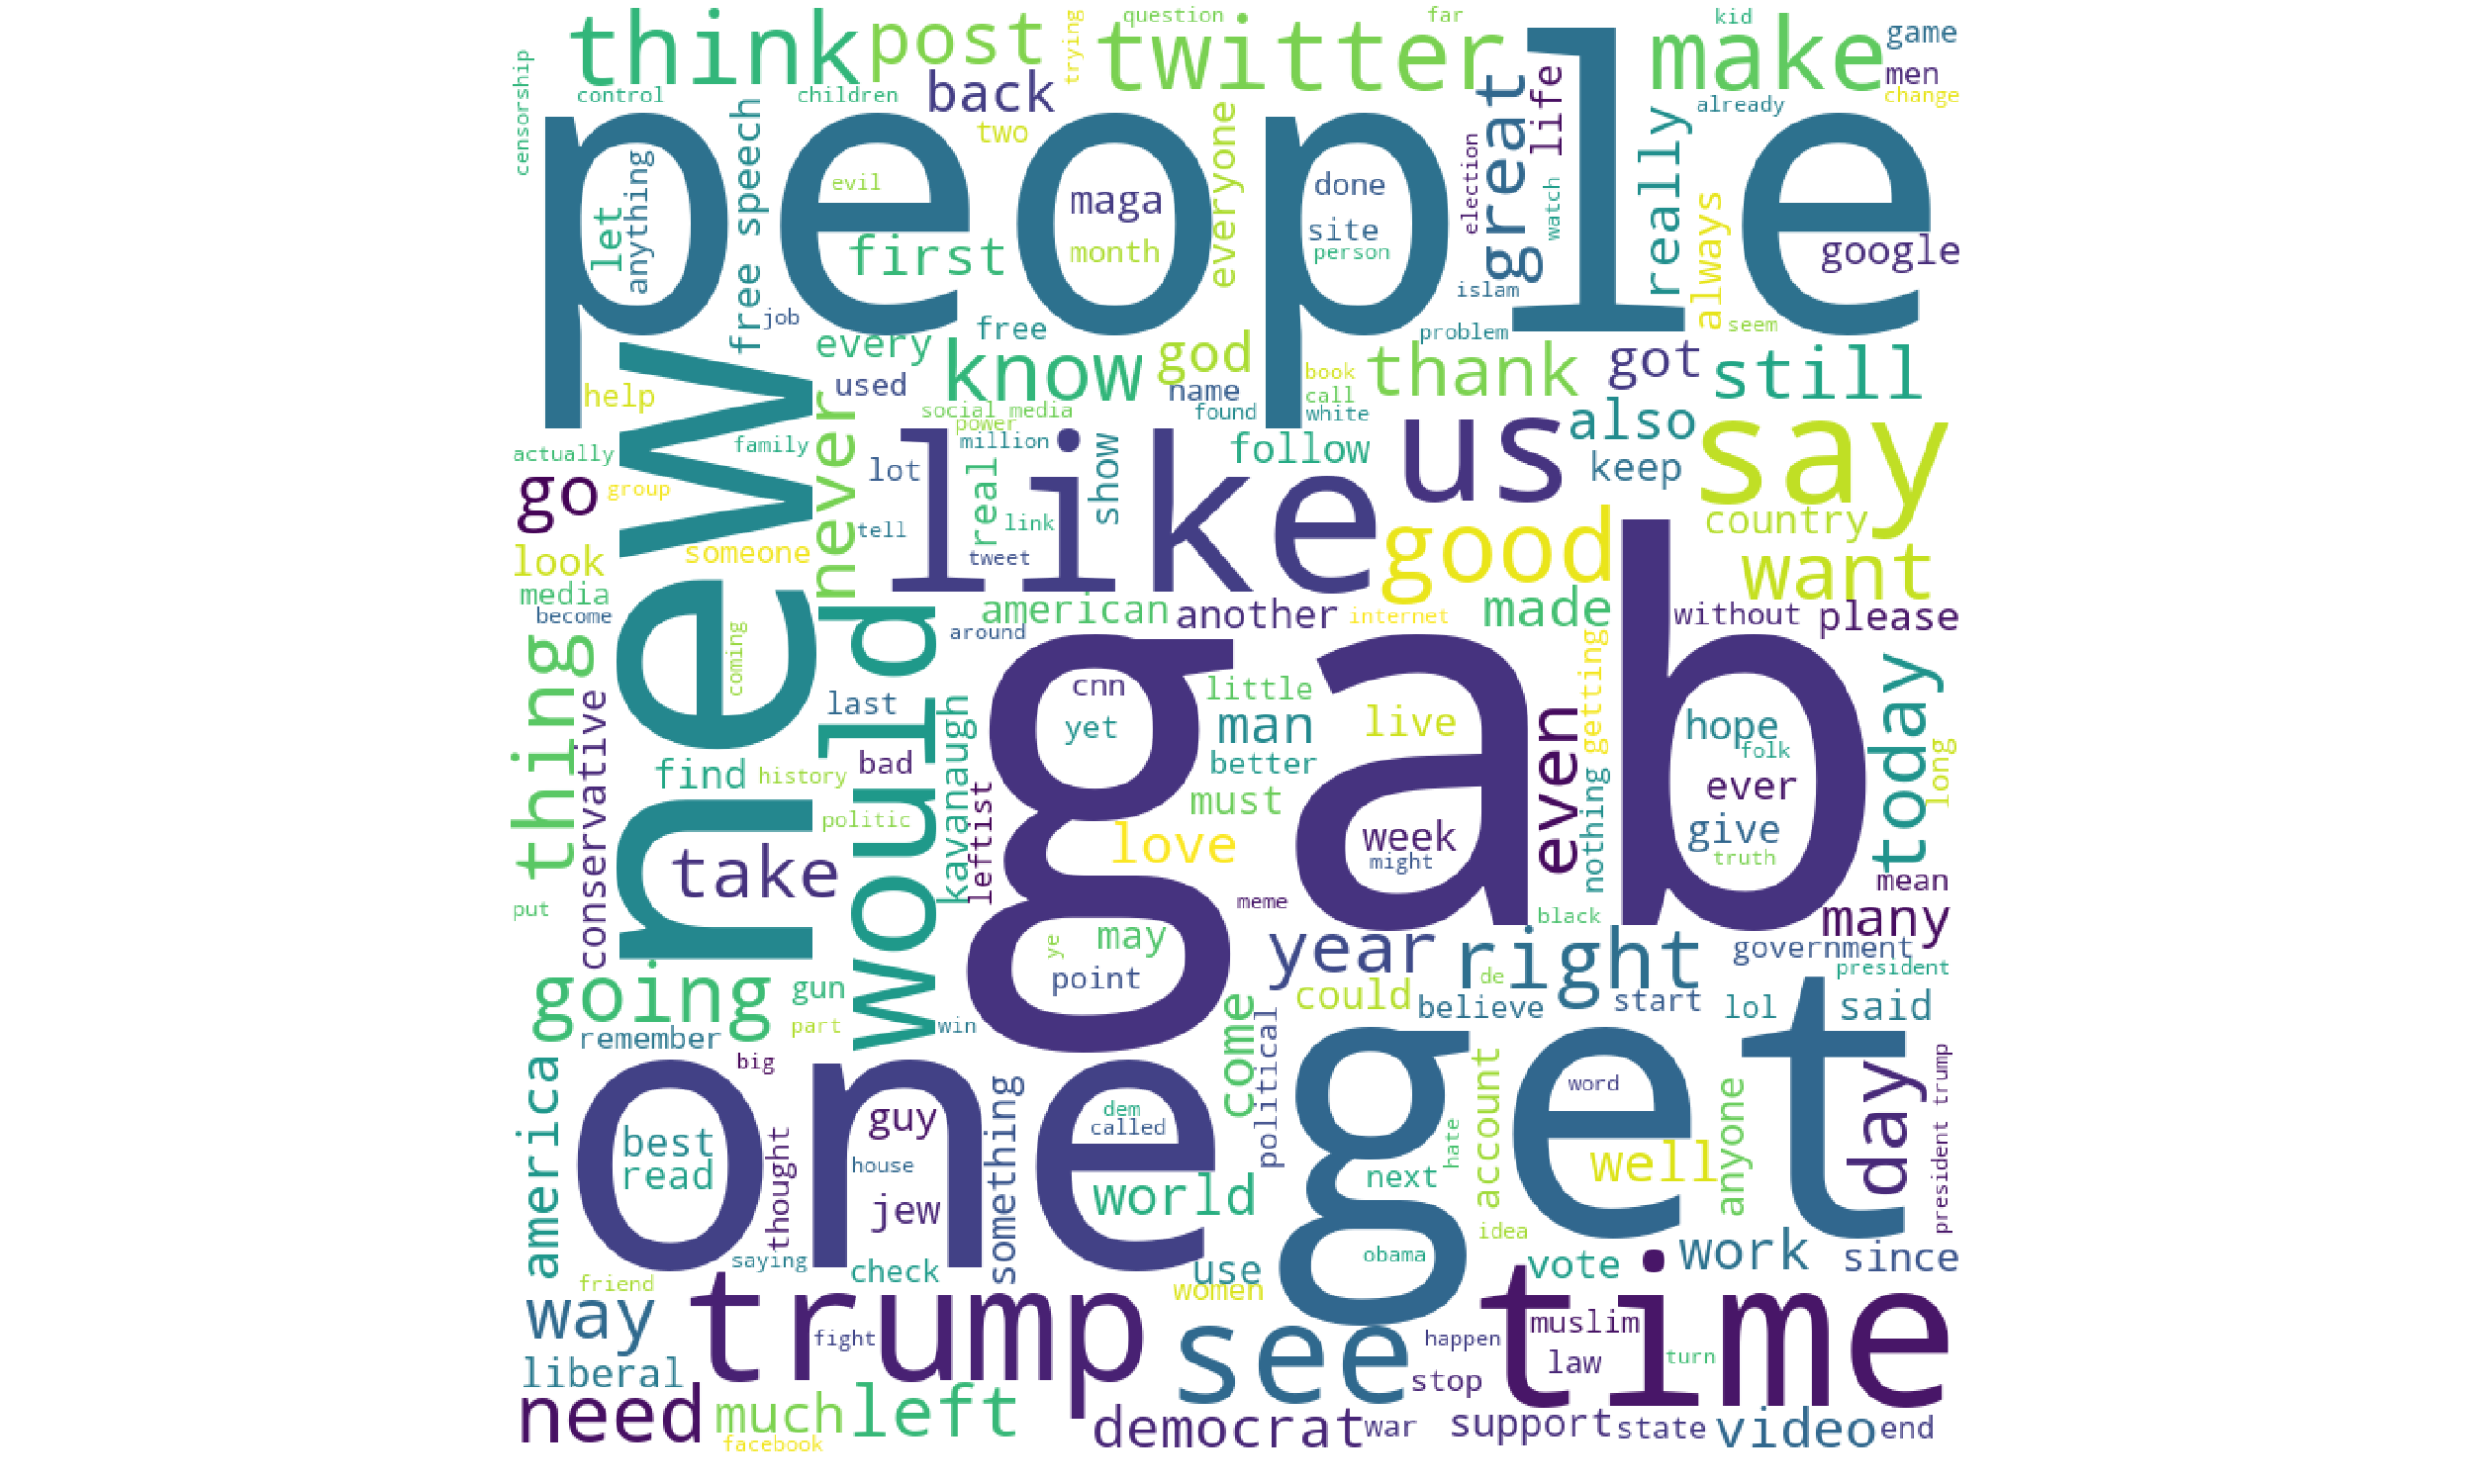
Neutral words
Robert Bowers
All of Gab

